Slide 1

DENTAL CLINIC
Team
Erarica Mehra (002113683)
mehra.e@northeastern.edu
Pramod Chandraprakash (001563759)
sony.p@northeastern.edu
Sagar Jalindar Khandagale(002197761)
khandagale.s@northeastern.edu
Vinit Hitesh Harsyra (002194175)
harsora.v@northeastern.edu

Slide 2

OPERATIONS
Dashboard with the following functionalities:
Adding Patient personal information, medical history, dental history and insurance information
Deleting patient information
Search and View patient details
Updating patient information

Slide 3
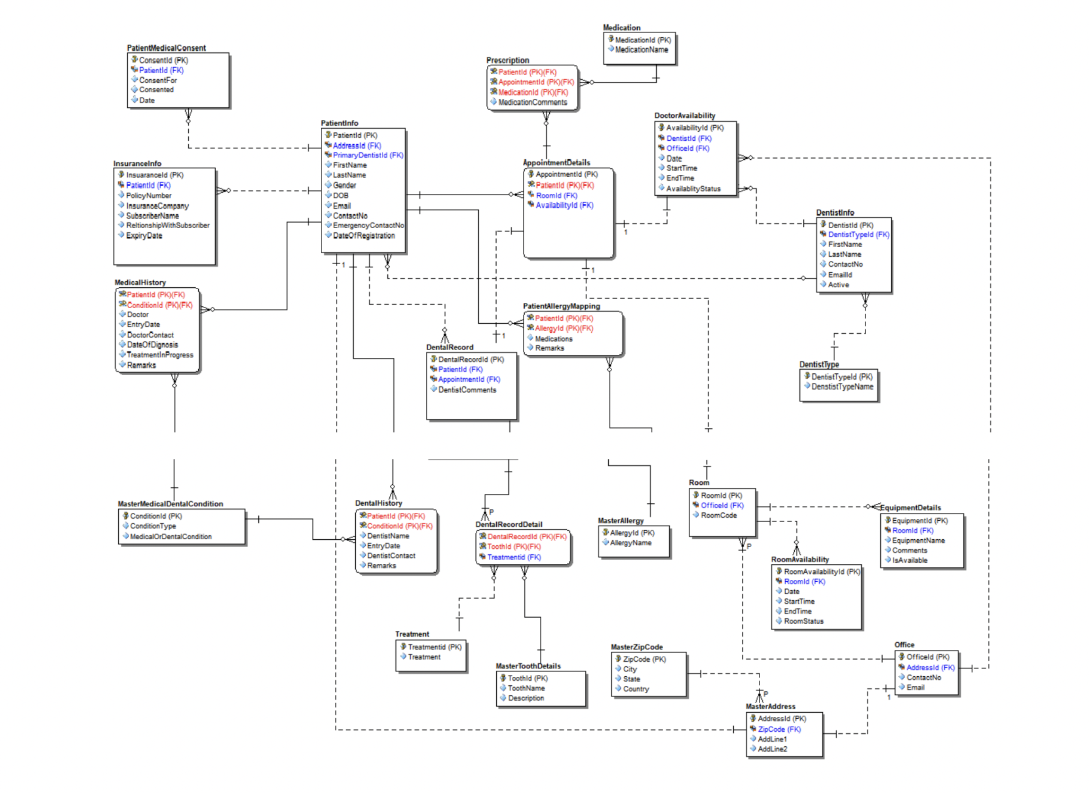
ER DIAGRAMS

Slide 4
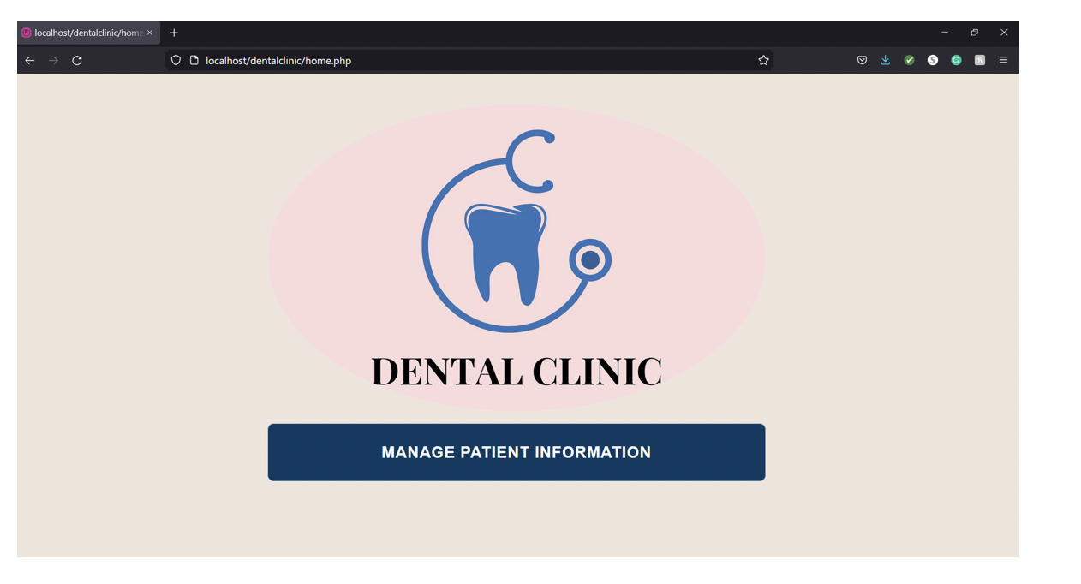
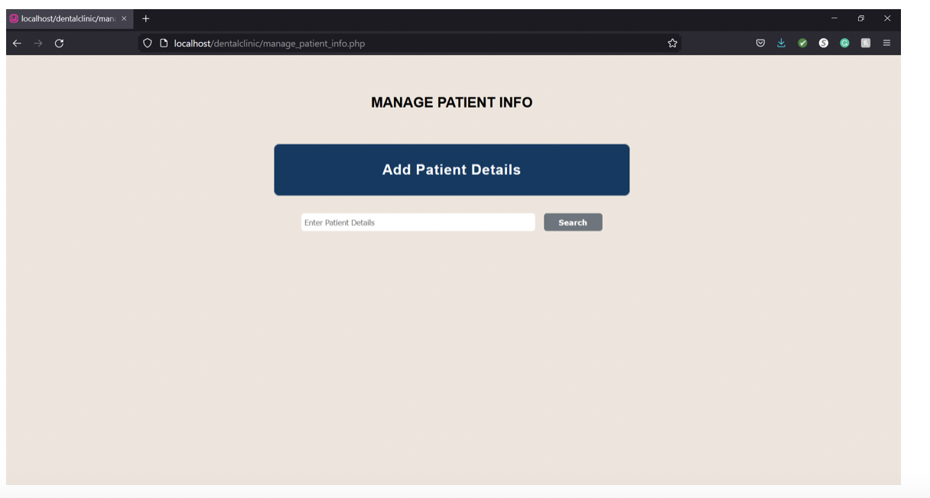
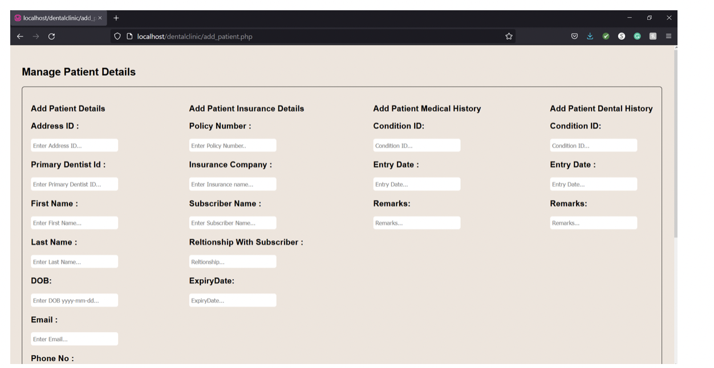
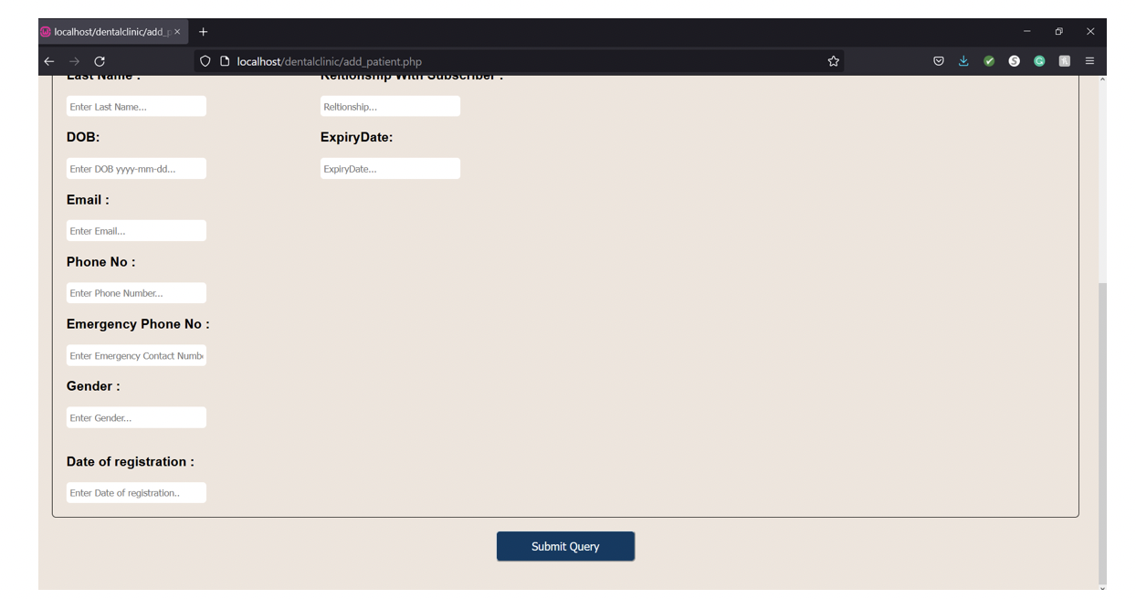
SCREENSHOTS

Slide 5
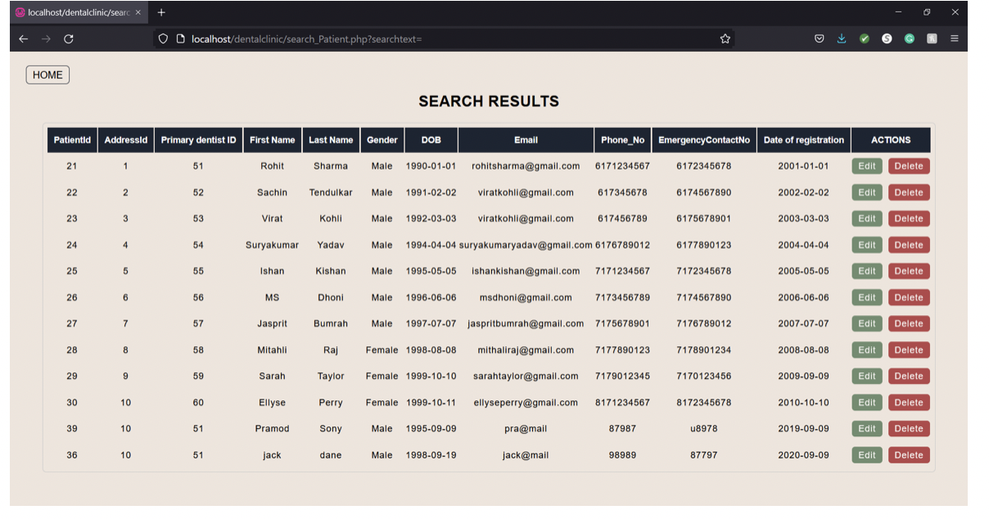
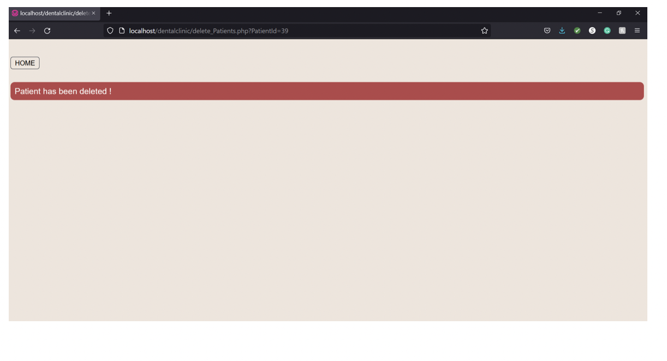
SCREENSHOTS

Slide 6




FUTURE ENHANCEMENTS
Implementing a Patient Login for Web Portal accessibility for patients to book appointments and view schedules.
Implementing functionality to register doctors. Implementing a Doctor Login for doctors to update their schedules and appointments.
Improving on the full stack architecture with an advanced functional UI
Enhancing the system to incorporate management of appointments and doctor’s schedules

Slide 7
THANK YOU

